Slide 1


“ FRESH-MART..”

Slide 2

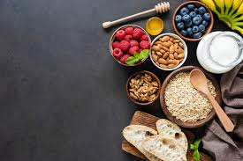
Presented by 1. Ganesh Aili 2. Kalyani Simma 3. Munnaza Fatima Sayed 4. Resham Kanhere 5. Yogini Kottewar Under the Guidance of Mrs. Pooja Mehta
Edubridge Batch : 2022-7679

Slide 3
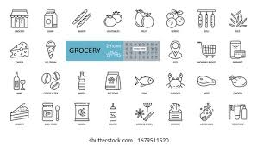
“ Introduction ”
A FRESH-MART is a retail online application that primarily sells vegetables, fruits, beverages , snacks. The main purpose of the fresh-mart is to create an online e-commerce platform for customers. It’s an online grocery shop where you can place your order according to your requirements. The following are the major advantages of the application are save time and travel expense to buy your daily needs, one-click and handy shopping, same price of the product according to the city or country, provide an online platform for every customer

Slide 4
“ Abstract “
“Health is Wealth”. As the saying goes from our ancient times. Eat healthy and stay healthy as of now a days its very difficult to have healthy.
Fresh-Mart must ensures that the application runs smoothly that items are priced comparatively and that customers are satisfied.
People are unable to find time to household works like buying grocery. So by this platform we provide grocery.
This is an Internet based application that can be accessed throughout the web.
This system can be used to search for all grocery and fresh vegetables , fruits which are available in the market.

Slide 5
“ Project Objective ”
To evaluate the interaction with the customers.
To develop a grocery ordering system with web application
To determine the factors that influence customer when ordering grocery online.

Slide 6

“ Analysis ”

Slide 7


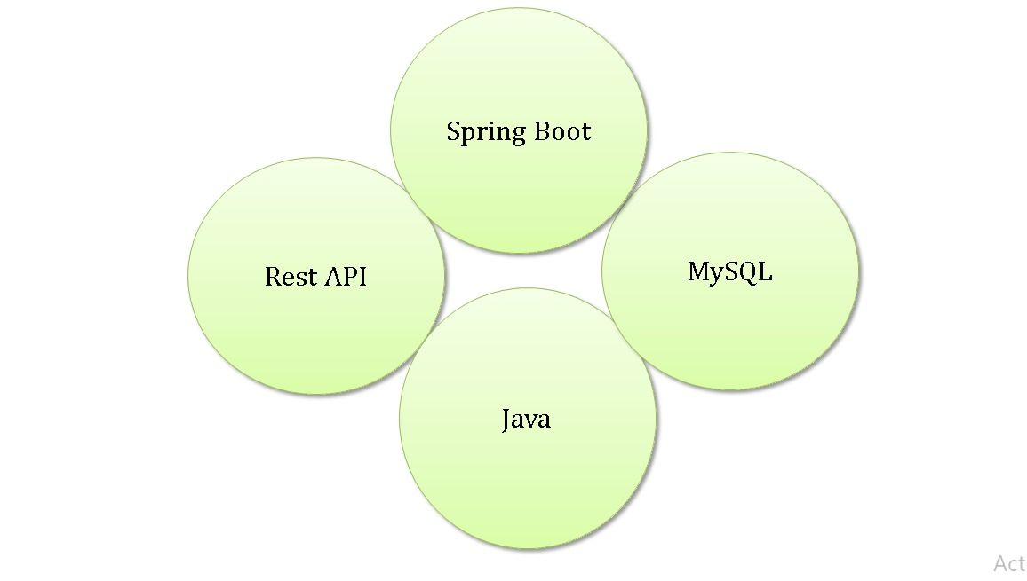

“ Back-End Technology Used ”

Slide 8
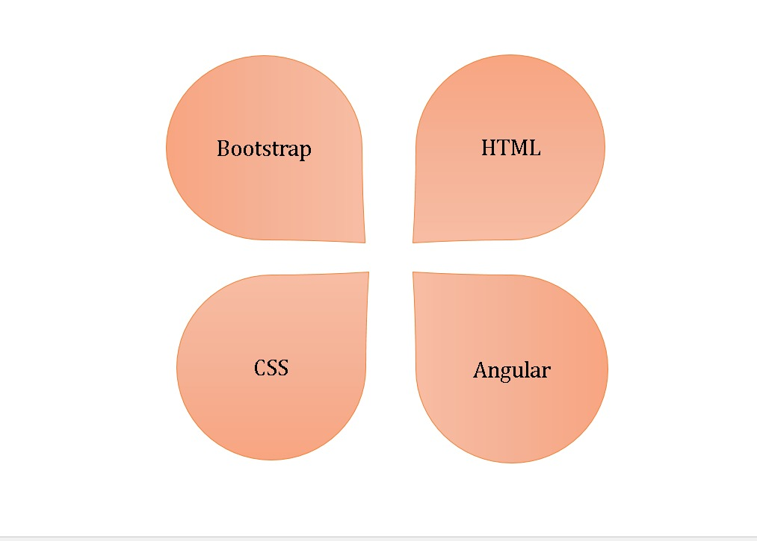

“ Front-End Technology Used ”

Slide 9

“ Required Specification ”
Hardware configuration :
1. Processor : Pentium-IV.
2. Hard Disk : 500 MB.
3. Ram : 2 GB.

Slide 10

Software configuration :
Software IDE : Eclipse, Visual Code.
Programming Language: JAVA.
Web Technologies : HTML, CSS , Bootstrap.
FrameWorks : Spring Boot, Angular JS , Hibernate.
Web Server : Apache Tomcat.
Databases : MySql.

Slide 11
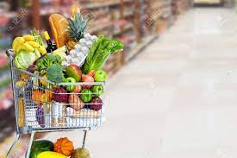
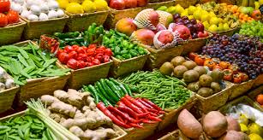

“ Design ”

Slide 12
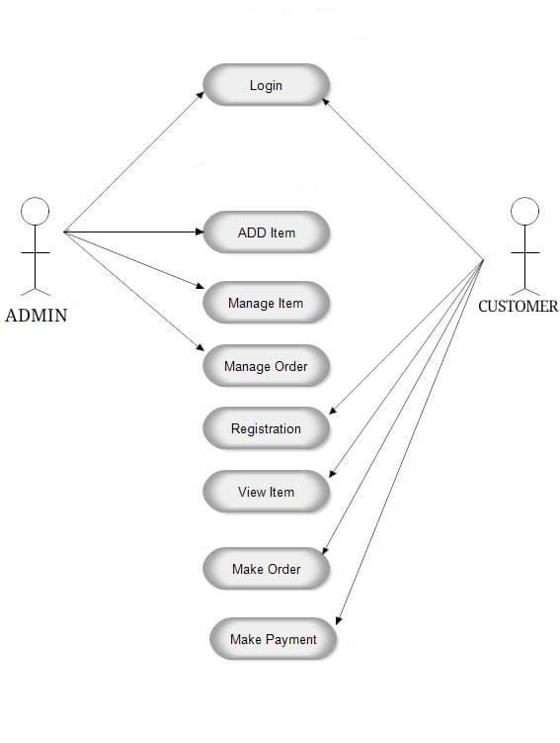
“ Use-Case Diagram ”

Slide 13
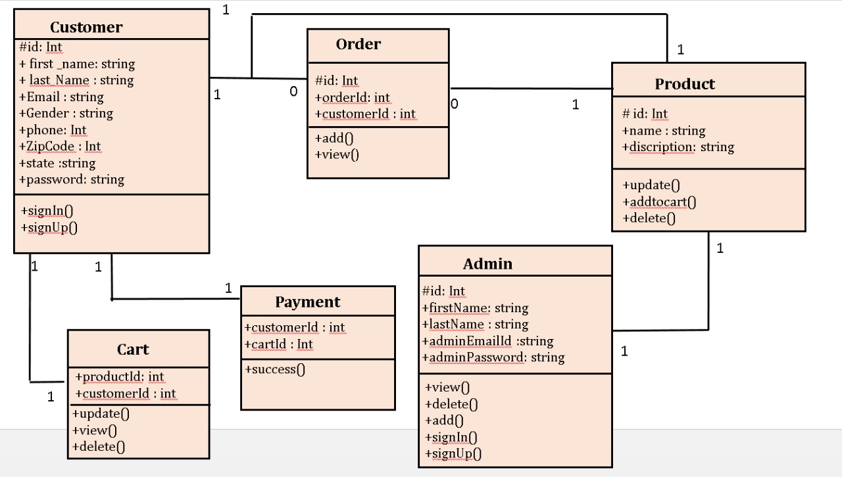
“ Class Diagram ”

Slide 14
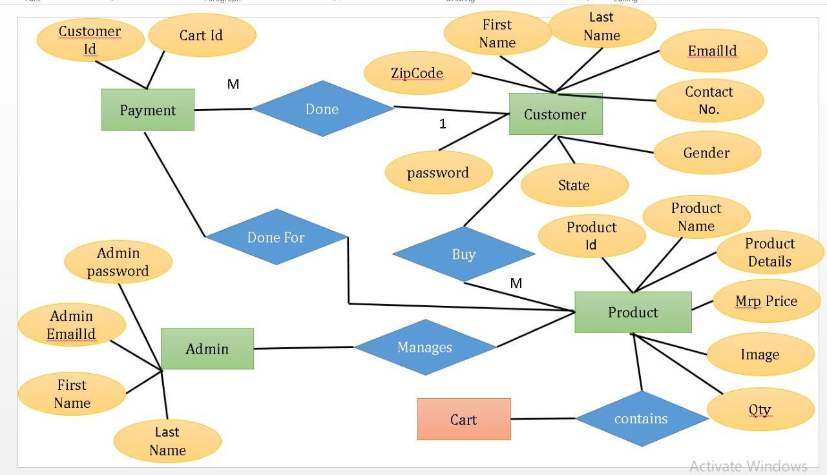
“ Implementation ”

Slide 15
Admin :
Admin has the official powers to control the flow of the data from one part of the system to the other.
He can manipulate the access of the users to the data.
Hence all the data will be reflected in clean and well data in the interfaces.
Customer :
Check the all products and give order of products. Check order status and see recently add cart products.
“ Modules ”

Slide 16
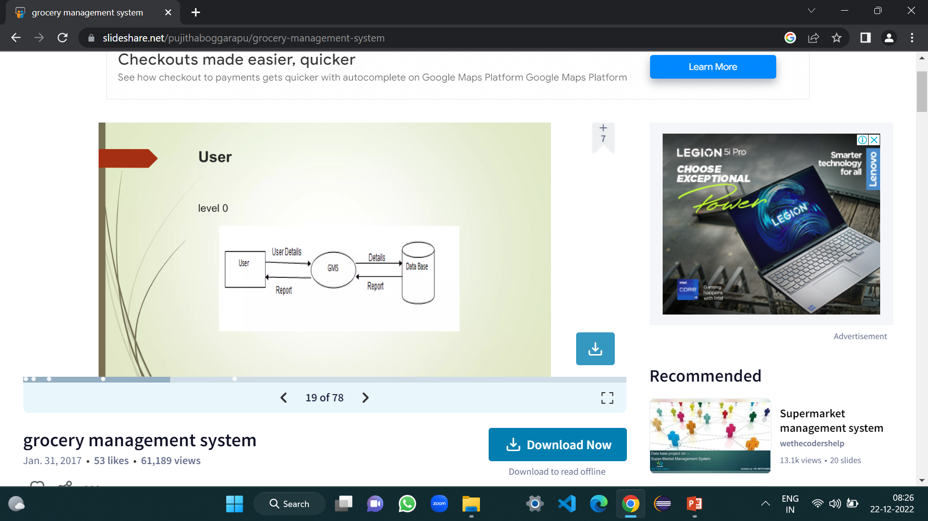
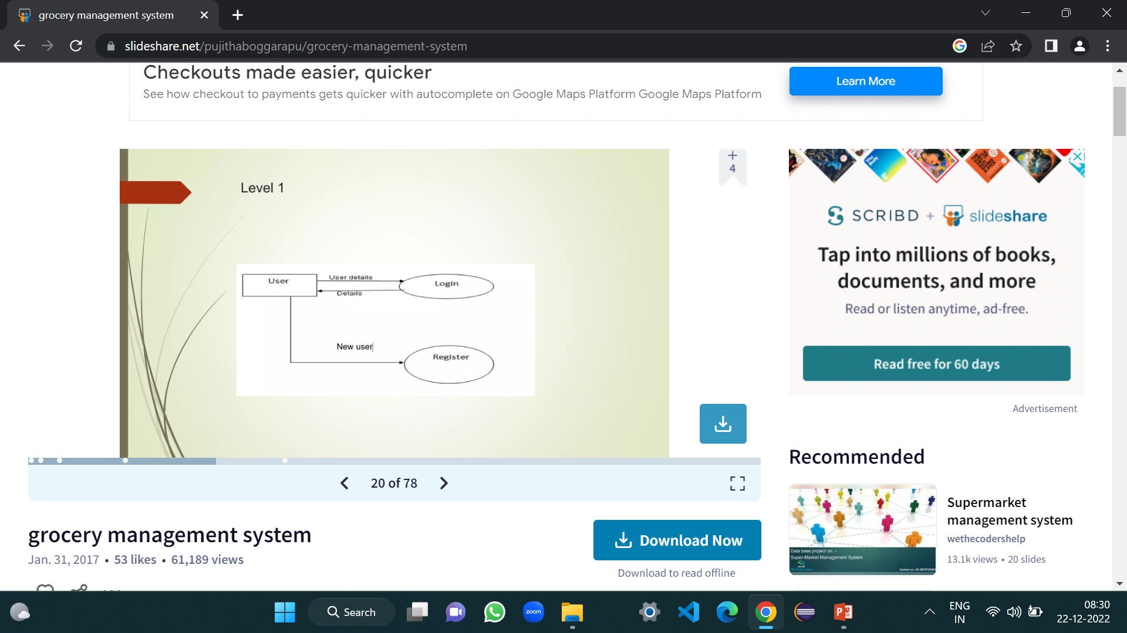
Customer/User
Registered customer/user

Slide 17
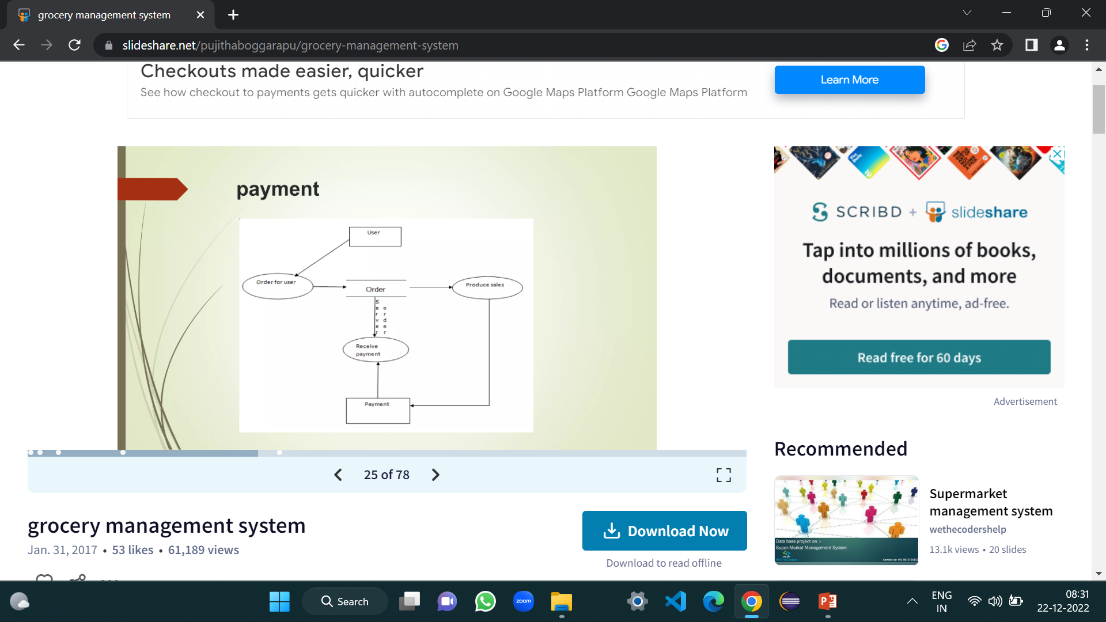
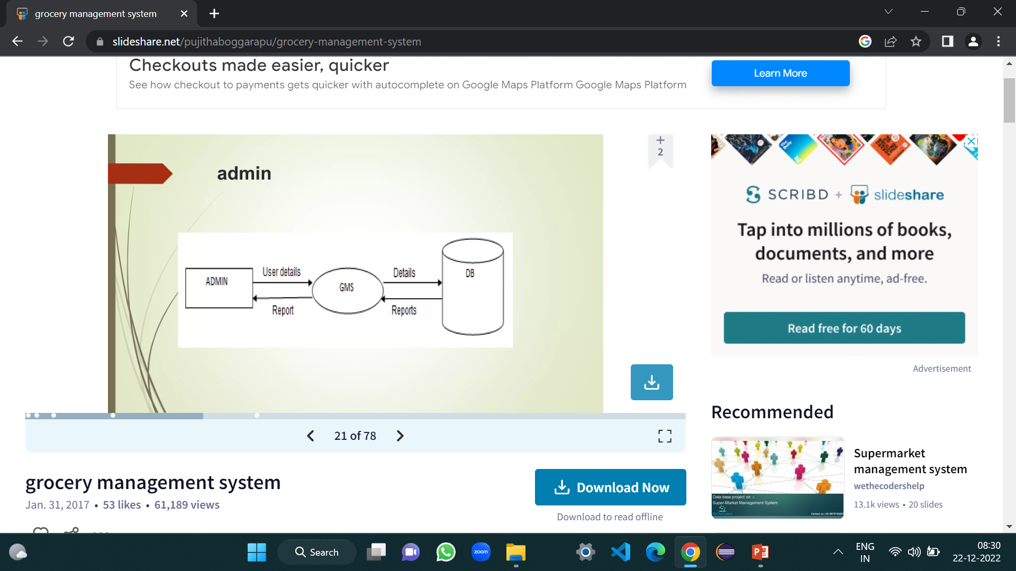
User did payment successfully
Admin

Slide 18
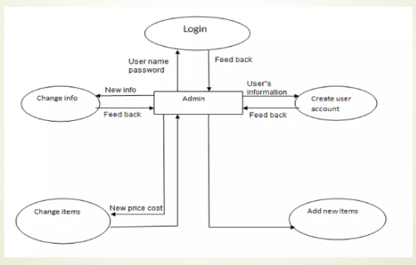
Admin

Slide 19
Order:
The order from the dealer is taken through phone and the products; quality is entered by an employee.
After that it resolve be saved in the database and a crystal account will have produced for billing purpose.
Cart : After trade, the products will be directed to the cart. In the cart unit we can get the total quantity of products available.
Payment : After ordering the payment will be done successfully.
Product : Detail information about product which is provided by admin.

Slide 20
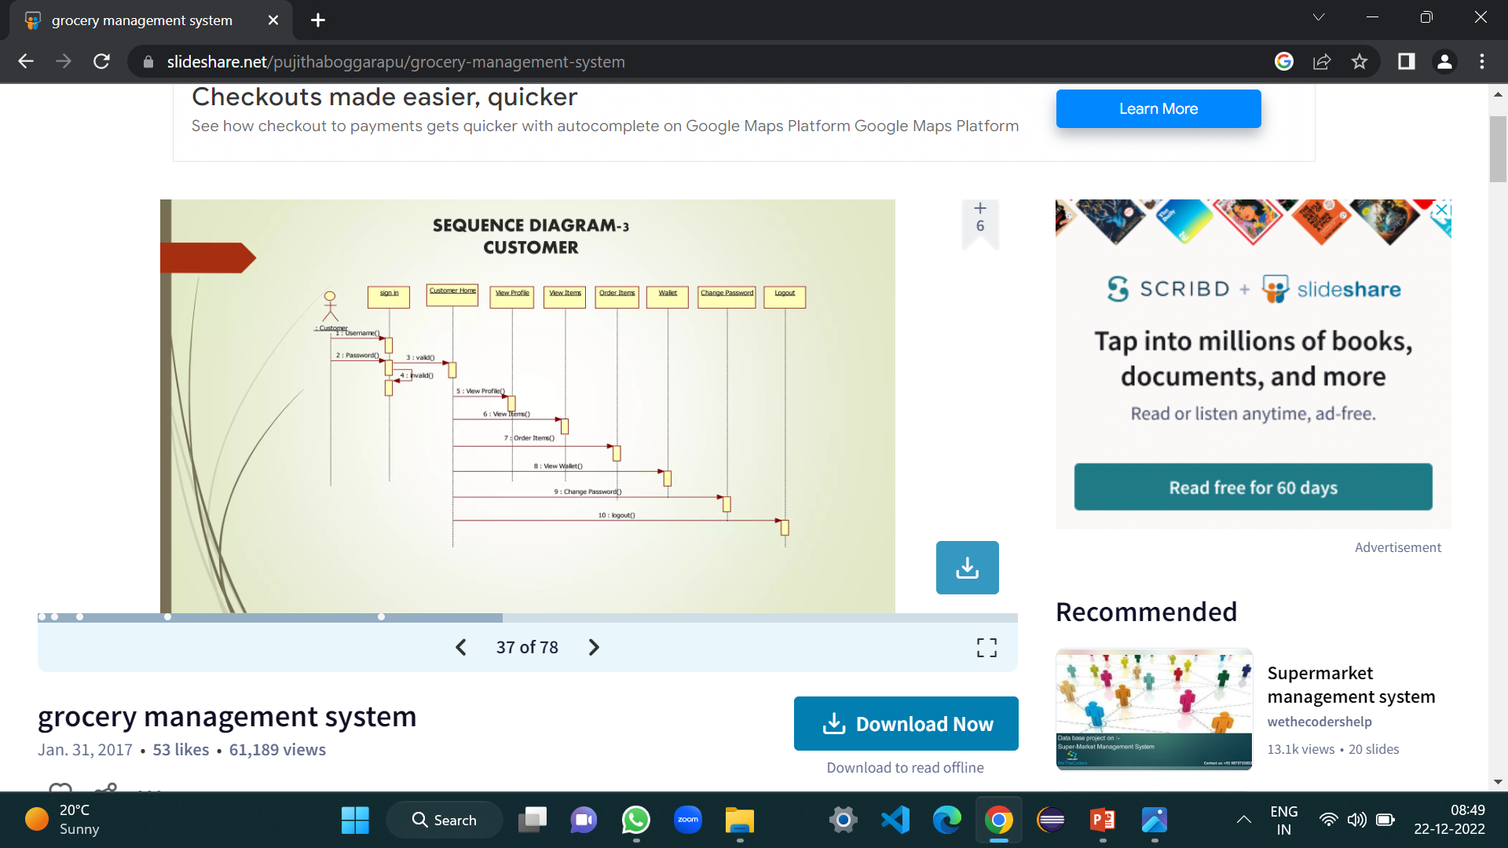
Sequence diagram for Customer

Slide 21
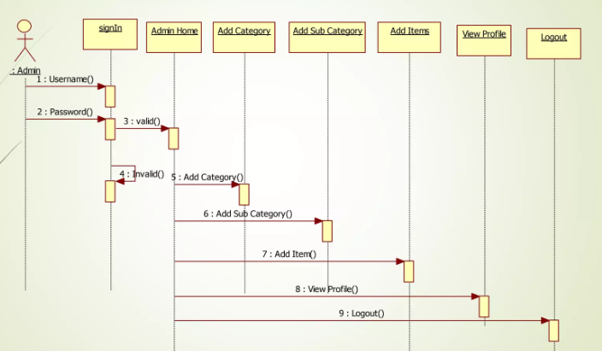
Sequence diagram for Admin

Slide 22
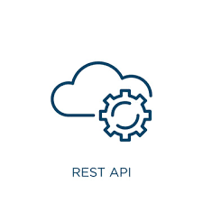
“ Rest API ”
1. Representational state transfer (REST) is an architectural style that defines a set of constraints to be used for creating web services. REST API is a way of accessing web services in a simple and flexible way without having any processing.
2. It’s used to fetch or give some information from a web service. All communication done via REST API uses only HTTP request.
3. An API for a website is code that allows two software programs to communicate with each other. The API spells out the proper way for a developer to write a program requesting services from an operating system or other application.
Working : A request is sent from client to server in the form of a web url as http get or post or put or delete request. After that, a response comes back from the server in the form of a resource which can be anything like HTML, XML, image, or JSON. But now JSON is the most popular format being used in web services.

Slide 23
In HTTP there are 4 methods that are commonly used in a rest-based architecture i.e., POST, GET, PUT, and DELETE. 1. GET : the HTTP GET method is used to read (or retrieve) a representation of a resource. In the safe path, GET returns a representation in XML or JSON and an HTTP response code of 200 (OK). In an error case, it most often returns a 404 (NOT FOUND) or 400 (BAD REQUEST). 2. POST : the POST verb is most often utilized to create new resources. In particular, it’s used to create subordinate resources. That is, subordinate to some other (e.g. Parent) resource. On successful creation, return HTTP status 201, returning a location header with a link to the newly-created resource with the 201 HTTP status. 3. PUT : it is used for updating the capabilities. However, PUT can also be used to create a resource in the case where the resource ID is chosen by the client instead of by the server. In other words, if the PUT is to a URI that contains the value of a non-existent resource ID. On successful update, return 200 (or 204 if not returning any content in the body) from a PUT. 4. DELETE : it is used to delete a resource identified by a URI. On successful deletion, return HTTP status 200 (OK) along with a response body.

Slide 24
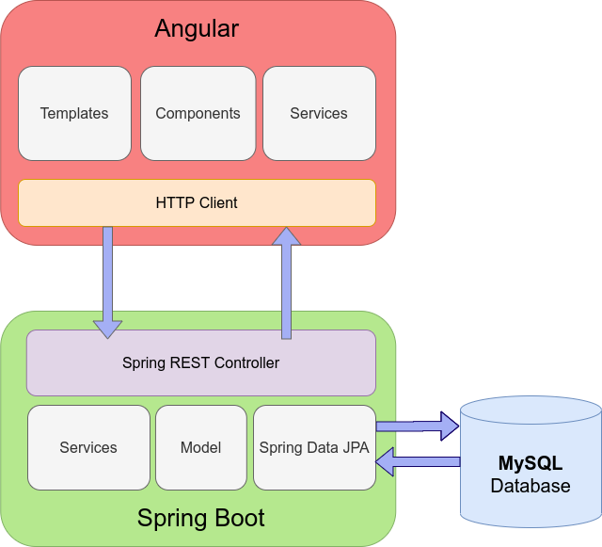
“ System Flow Diagram ”

Slide 25
We can distinguish three main layers: 1. Front-end - with angular 11 as the main framework, with templates, components and HTTP client for communication with the rest-full application server, 2. Back-end - server side with spring boot, spring REST controllers, and spring data JPA for communication with the database, 3. Database - submitted data will be stored in the Mysql database.

Slide 26

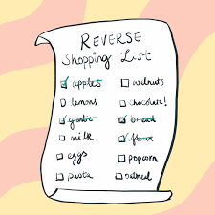
“ Output Screens ”

Slide 27
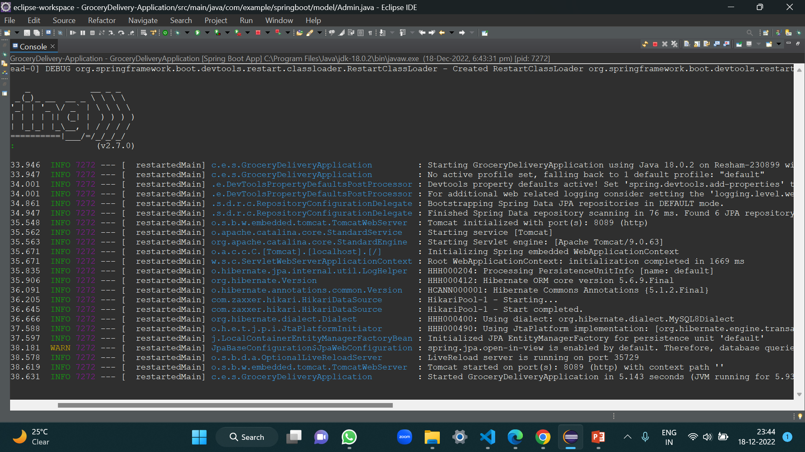
“ Spring Boot Project Running Successfully On
http://localhost:8089 ”

Slide 28
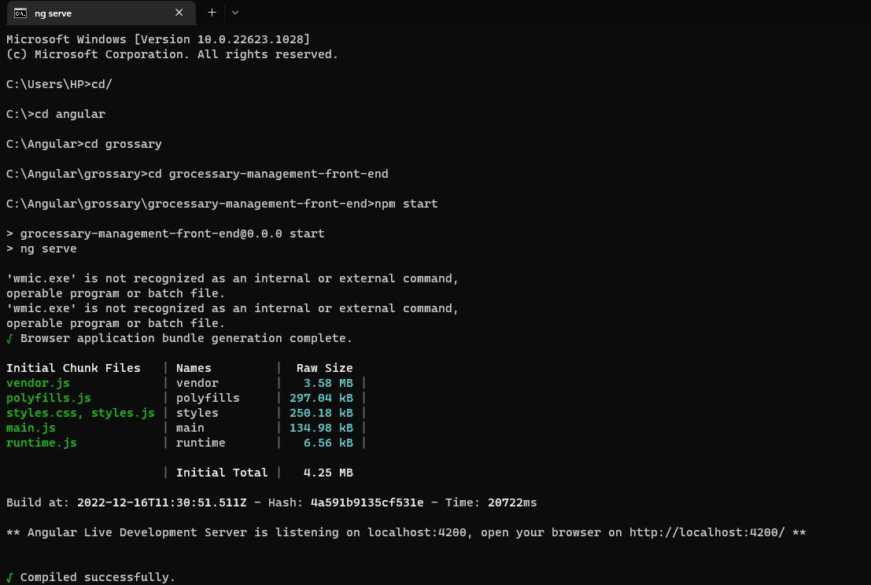
“ Angular Front-End Project Running Successfully On
http://localhost:4200 ”

Slide 29
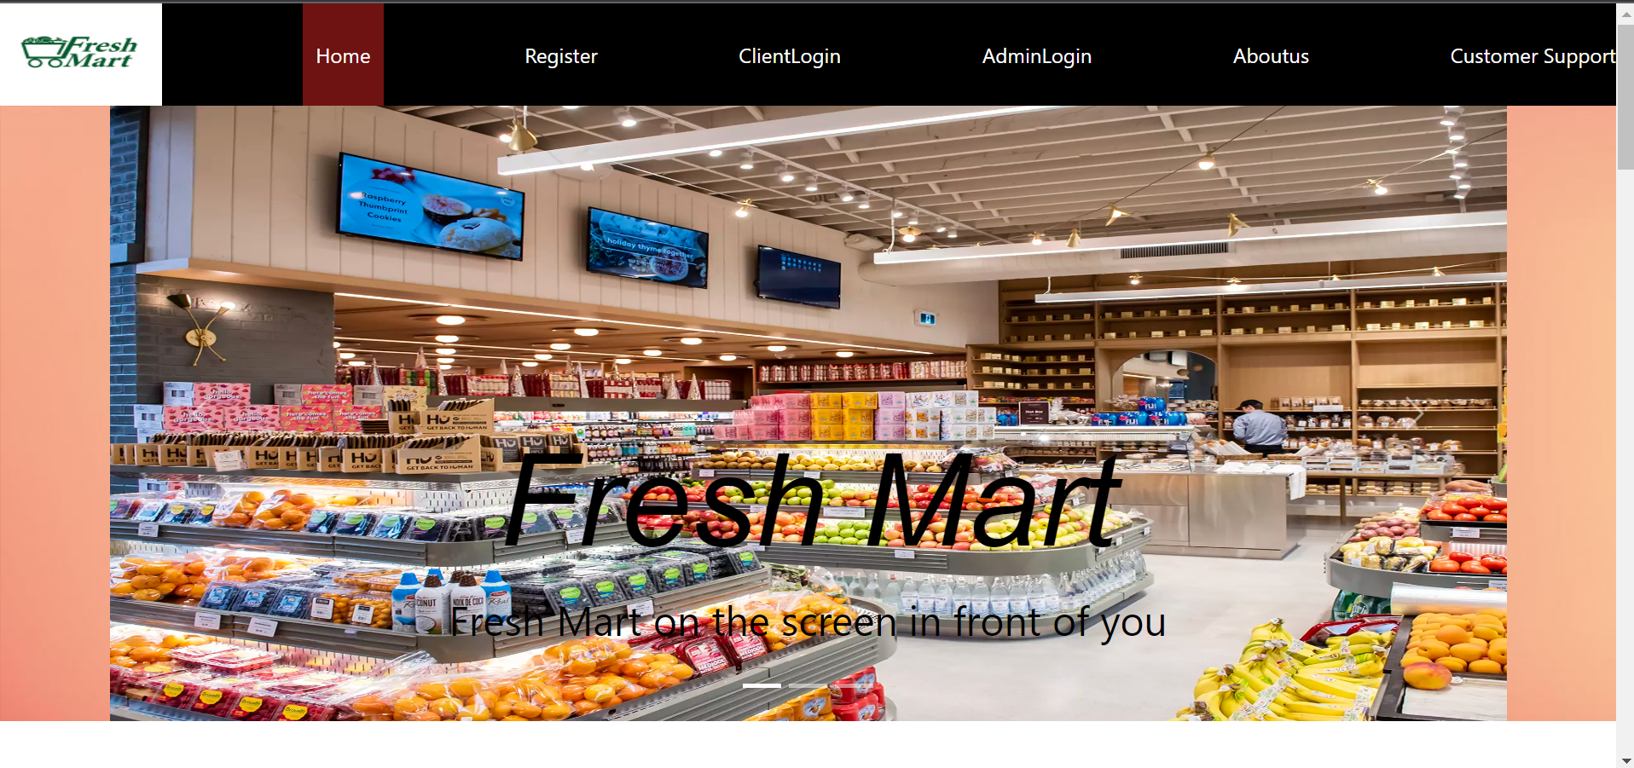
“ Welcome To Home Page “

Slide 30
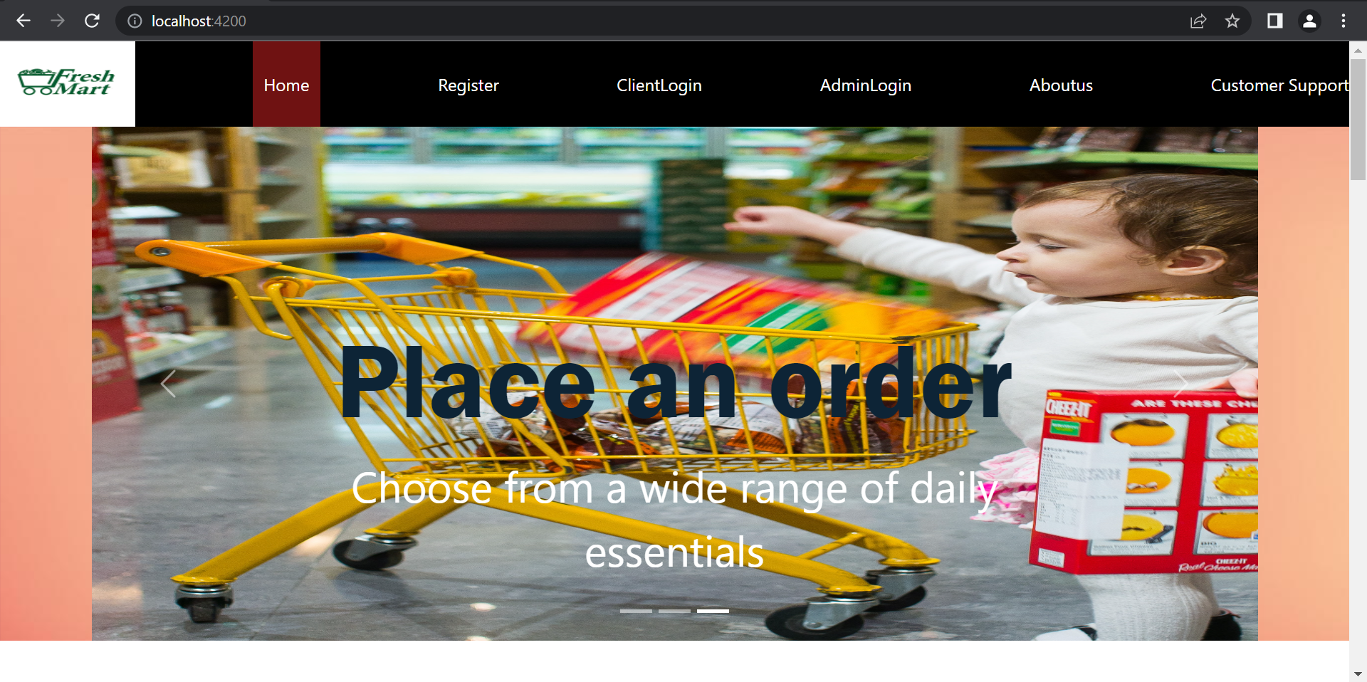

Slide 31
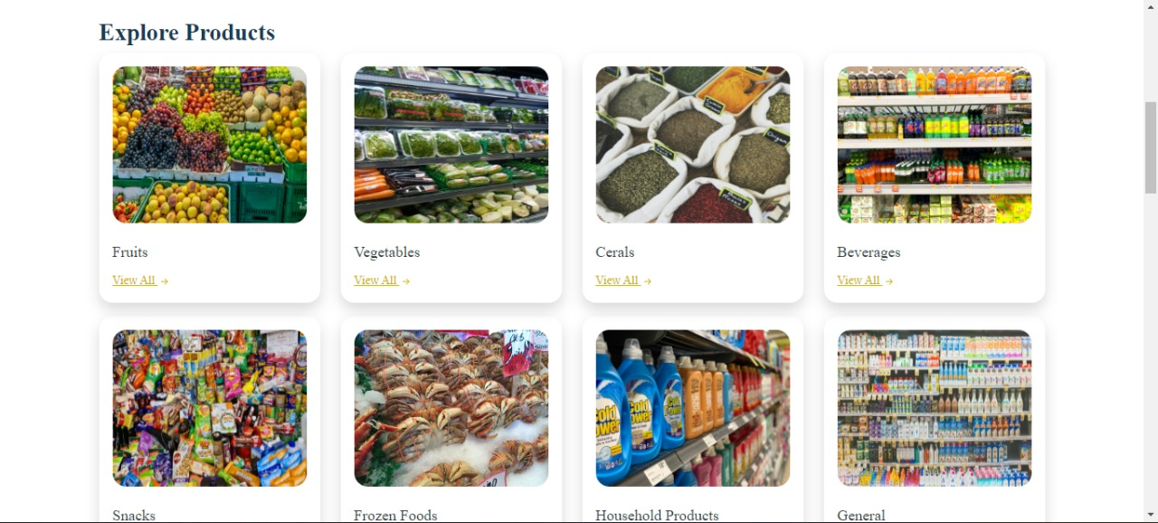

Slide 32
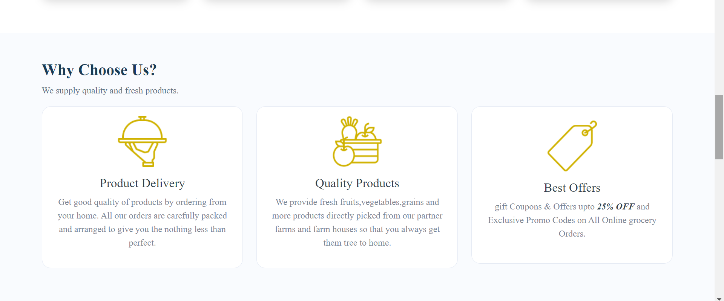

Slide 33
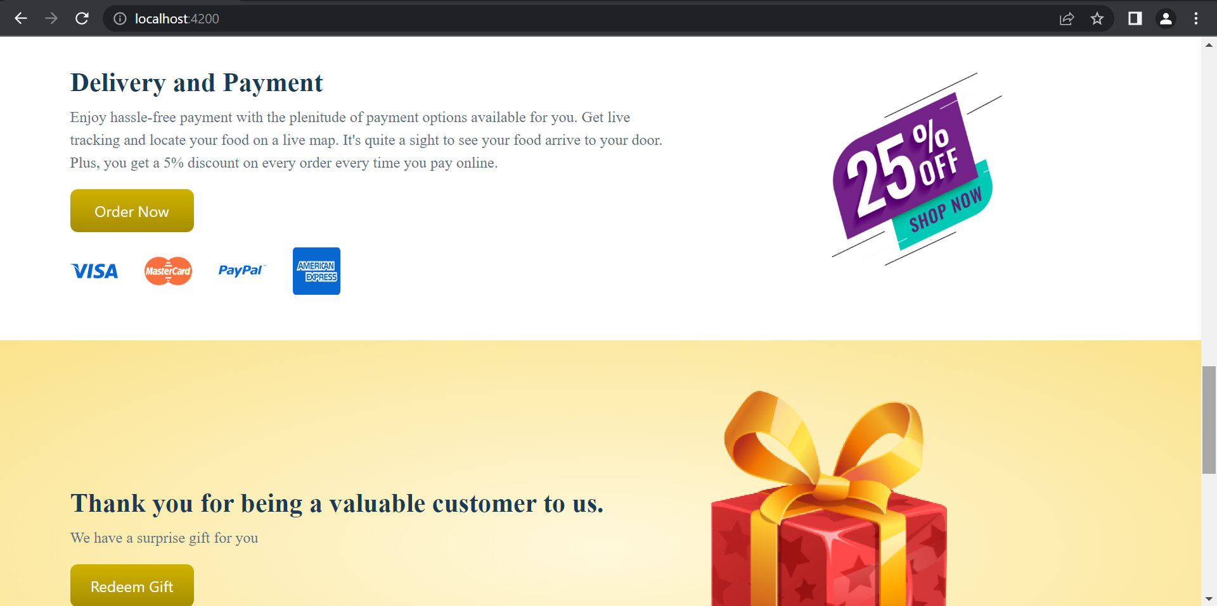

Slide 34
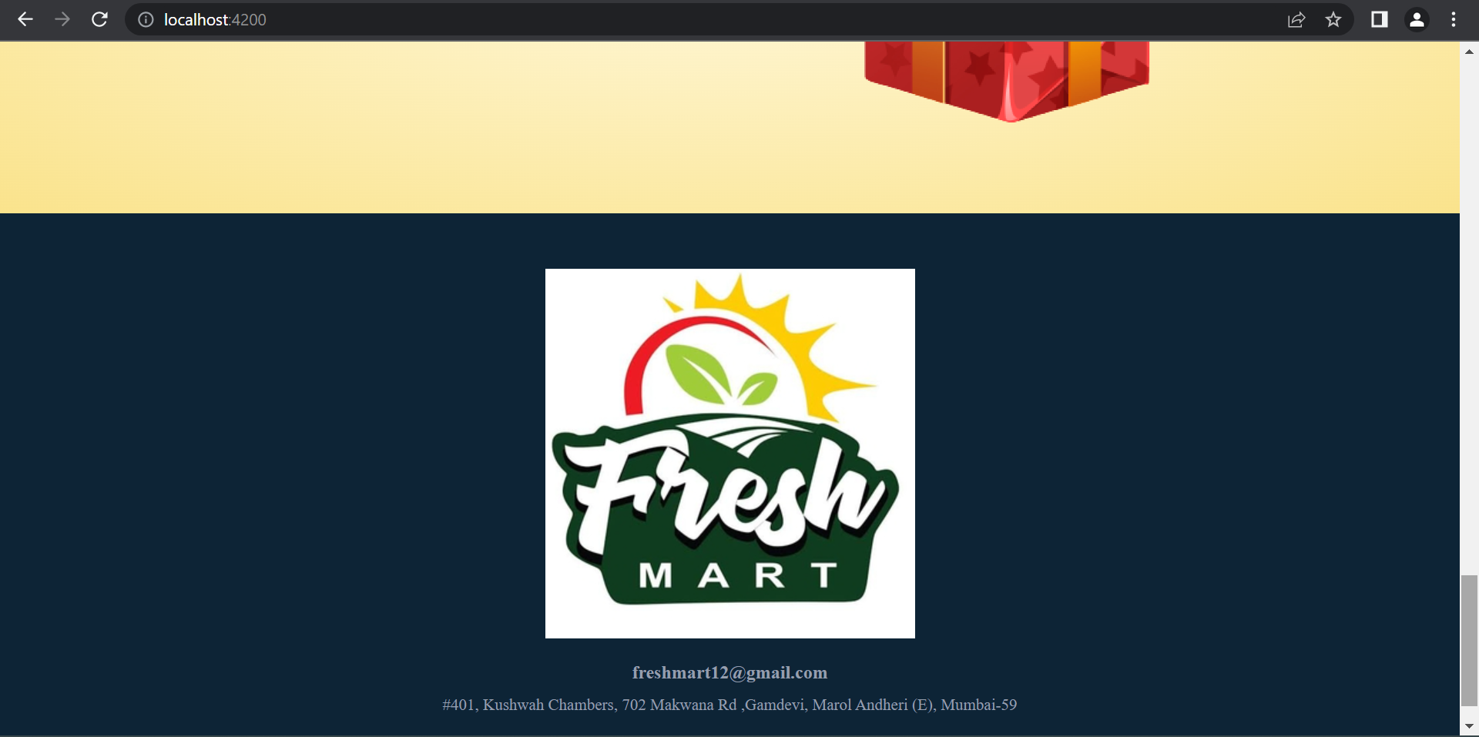

Slide 35
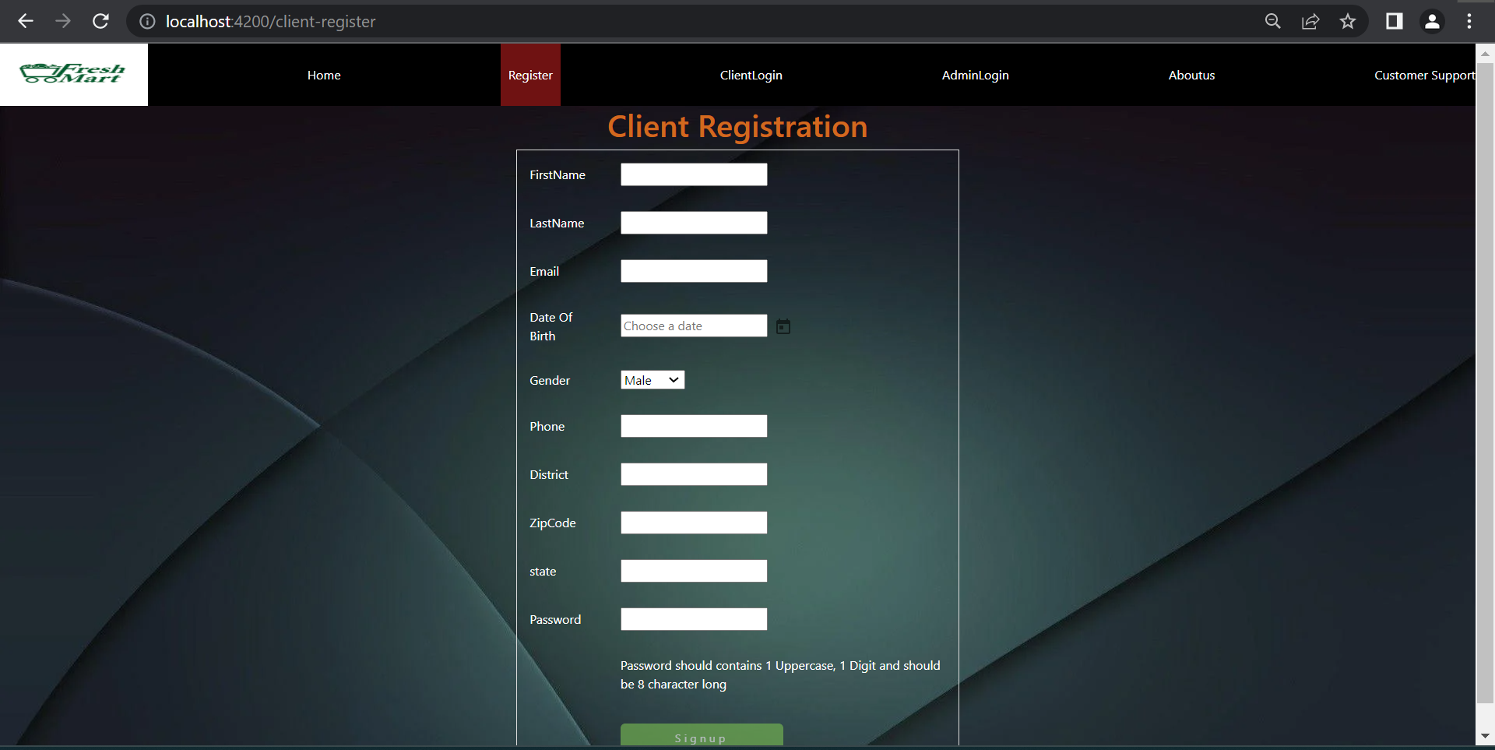
“ Client Registration Page “

Slide 36
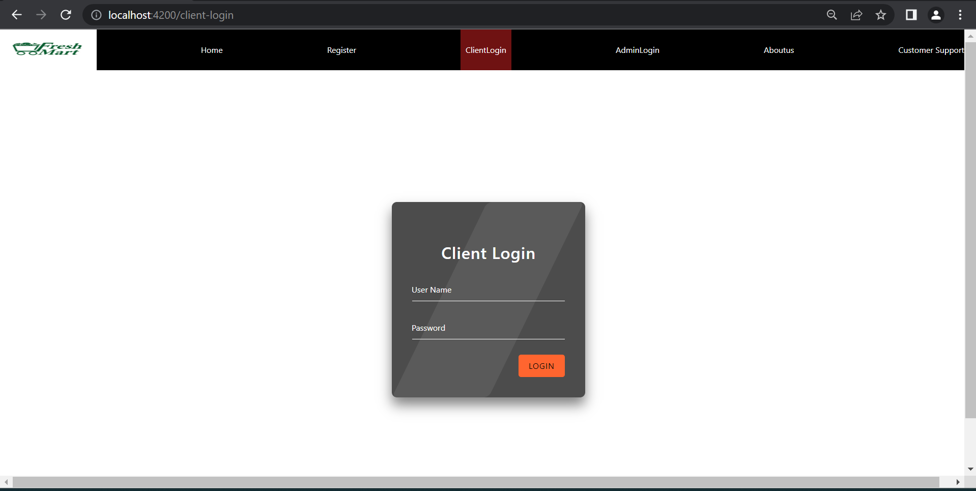
“ Client Login Page “

Slide 37
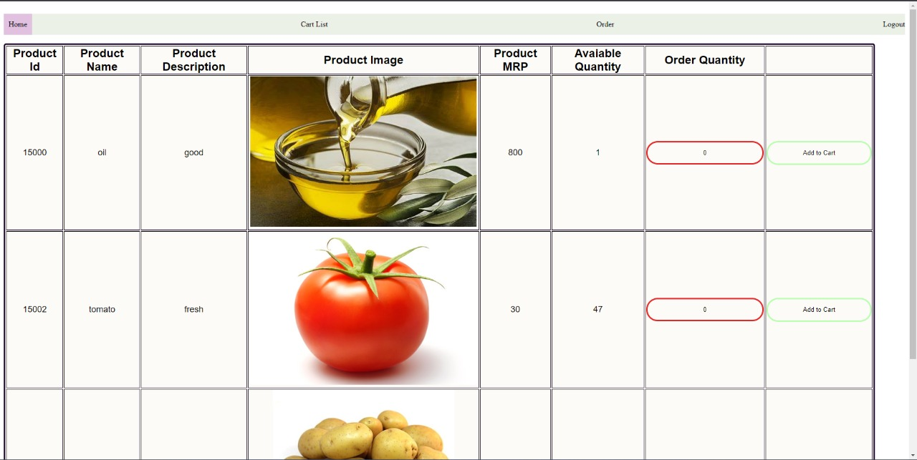
“ Client Home “

Slide 38
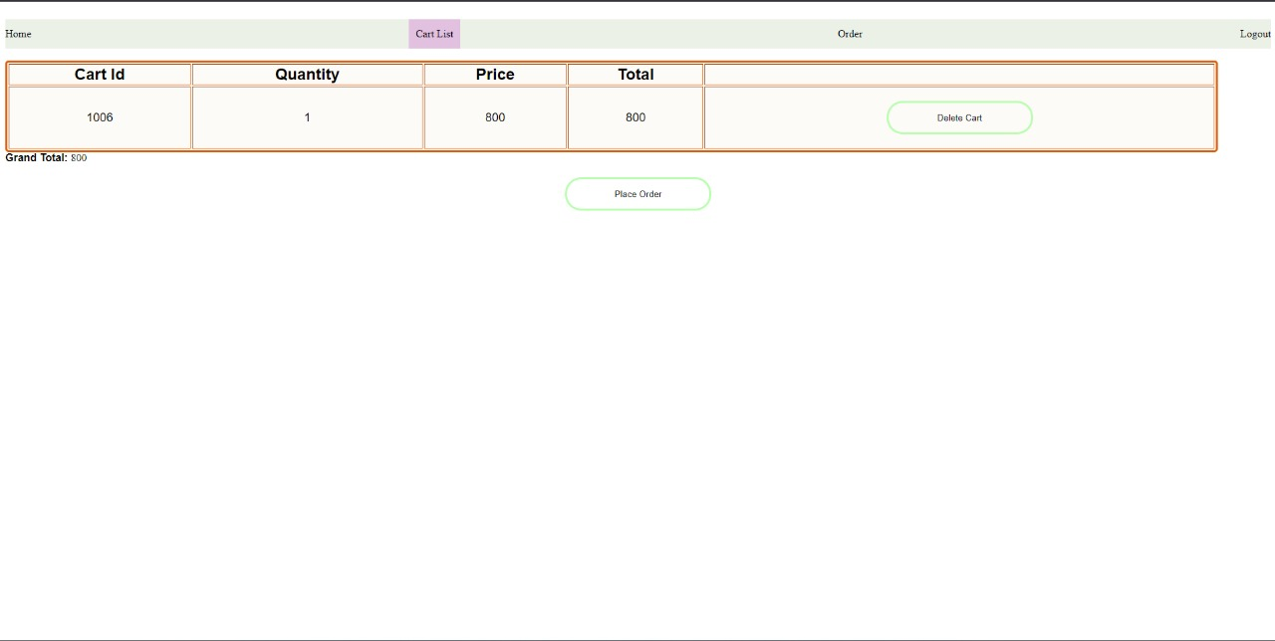
“ Client Add-to-Cart Page ”

Slide 39
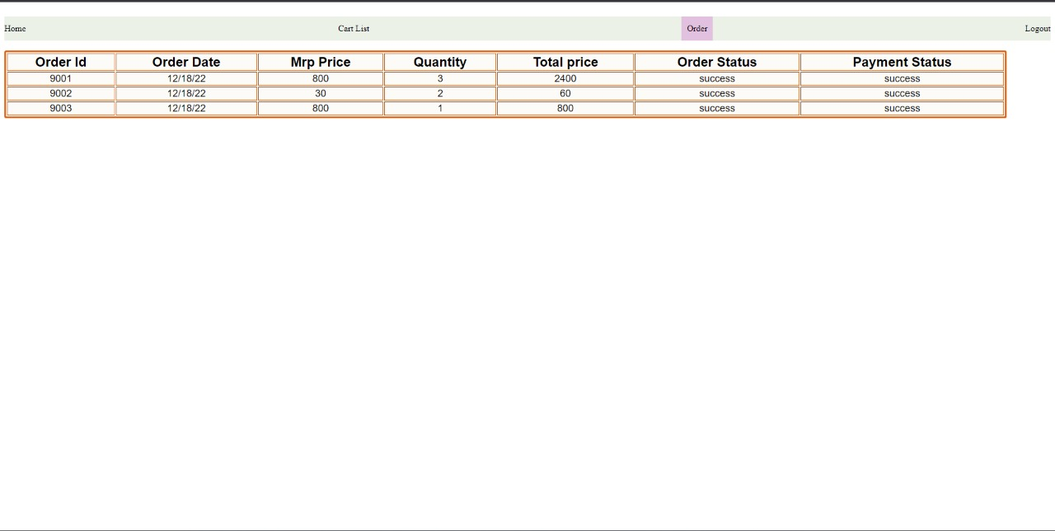
“ Client Order Page “

Slide 40
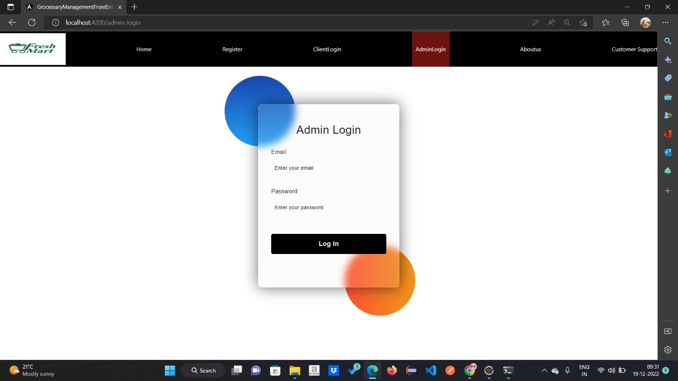
“ Admin Login Page “

Slide 41
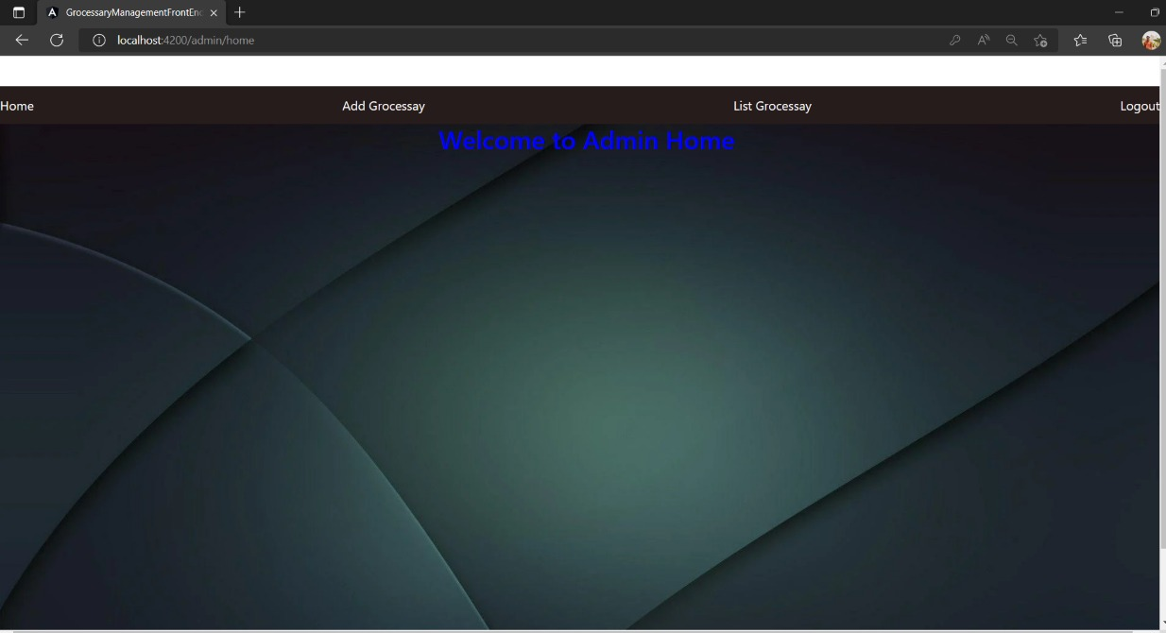
“ Admin Home Page “

Slide 42
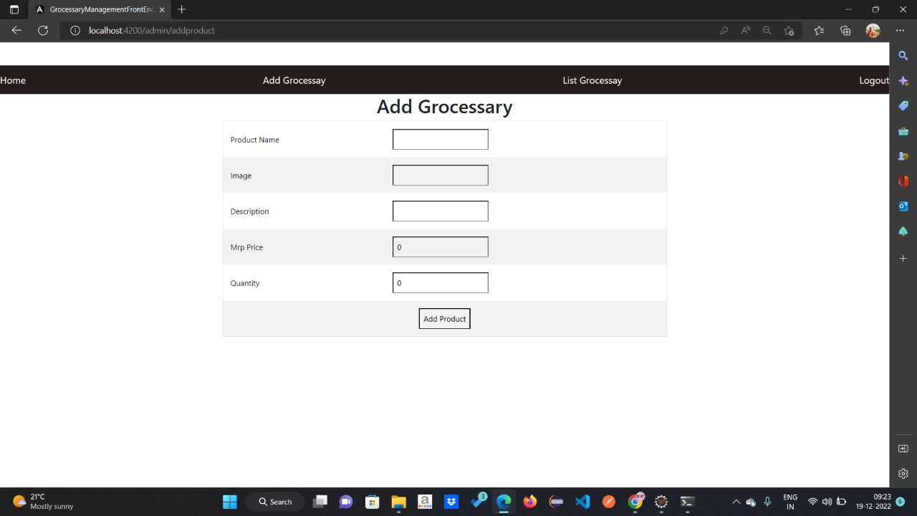
“ Admin Add Grocery Page “

Slide 43
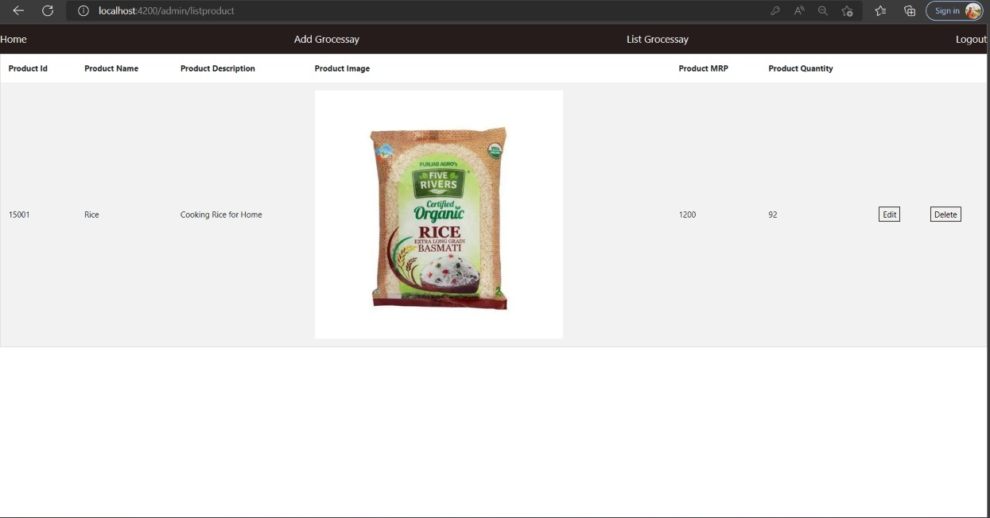
“ Admin Product List Grocery Page “

Slide 44
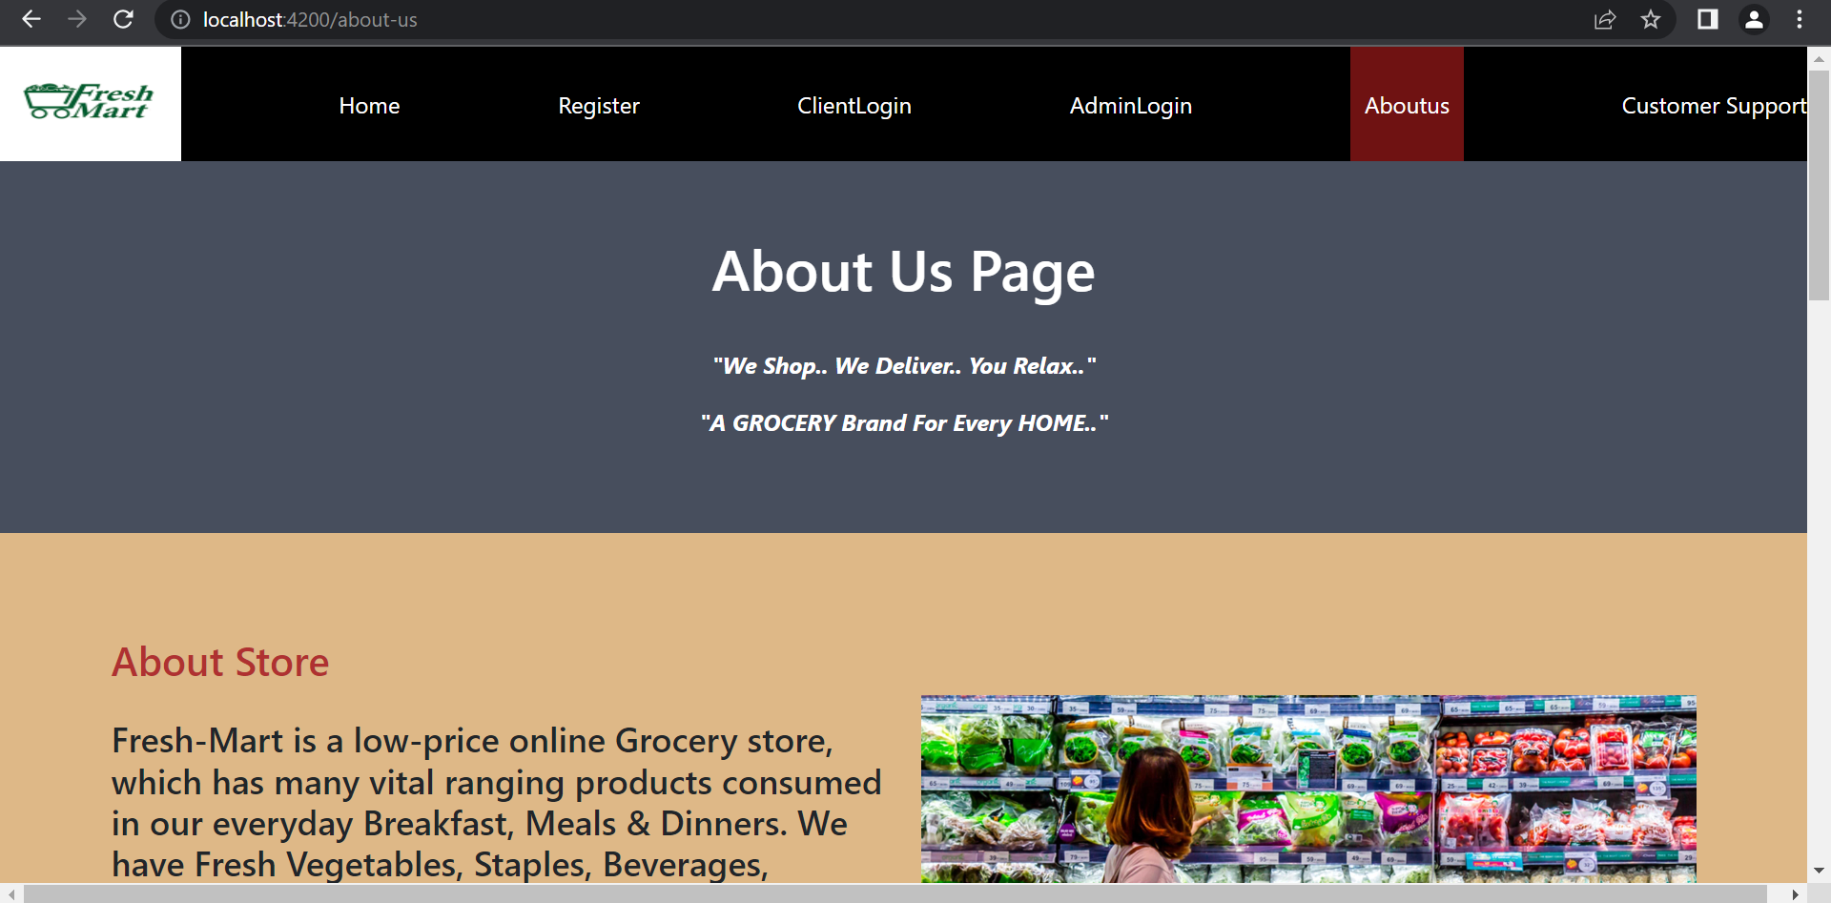
“ About Us Page “

Slide 45
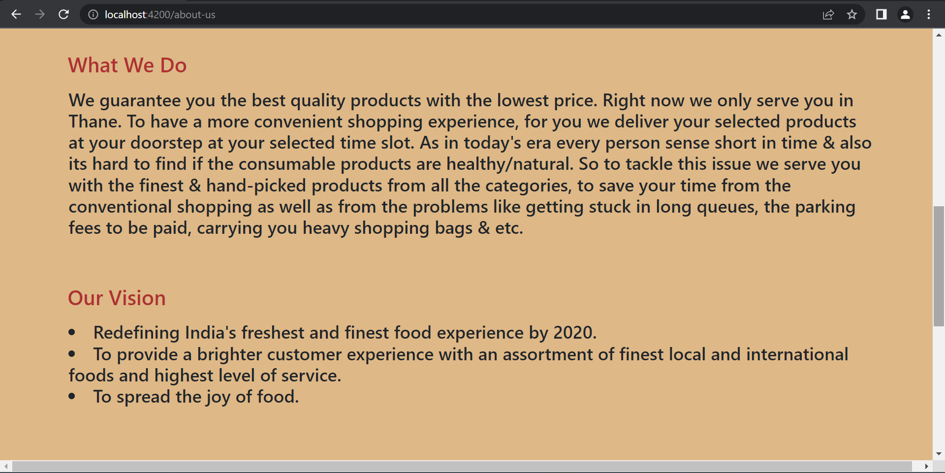

Slide 46
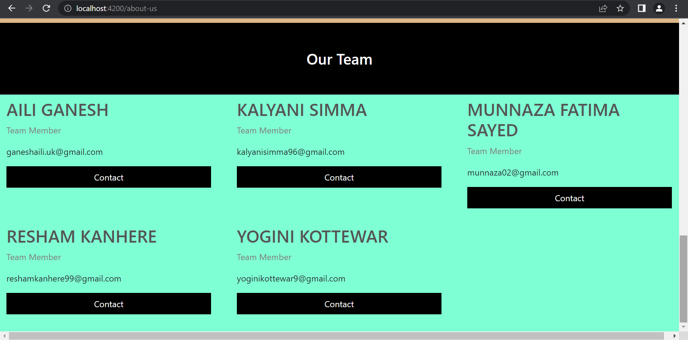

Slide 47
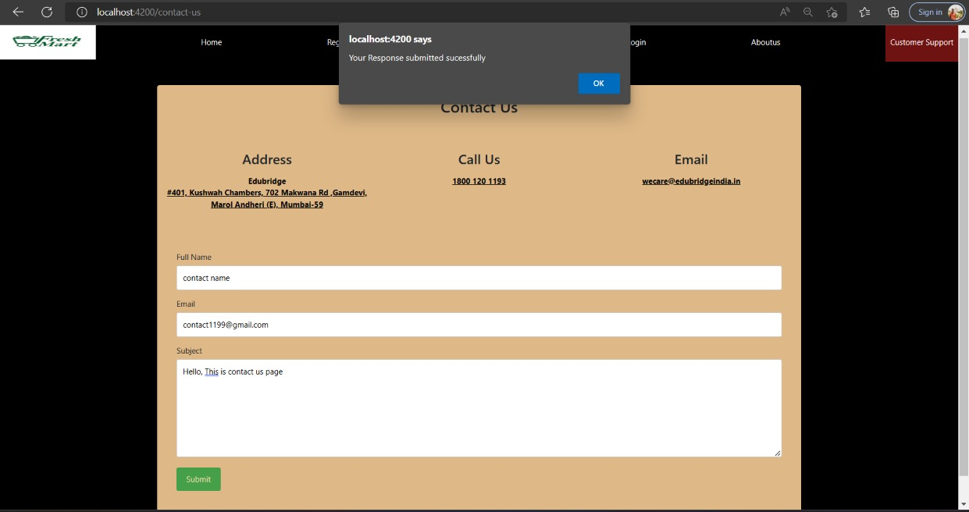
“ Contact Us Page “

Slide 48

“ MySQL Database “
MySQL is an open-source relational database management system (RDBMS).
A relational database organizes data into one or more data tables in which data may be related to each other; these relations help structure the data. SQL is a language programmers use to create, modify and extract data from the relational database, as well as control user access to the database.
MySQL has stand-alone clients that allow users to interact directly with a MySQL database using SQL, but more often, MySQL is used with other programs to implement applications that need relational database capability.
Features:
MySQL is offered under two different editions: the open source MySQL Community Server and the proprietary Enterprise Server. MySQL Enterprise Server is differentiated by a series of proprietary extensions which install as server plugins, but otherwise shares the version numbering system and is built from the same code base.

Slide 49
Major features as available in MySQL :
Cross-platform support
Stored procedures, using a procedural language that closely adheres to SQL/PSM
Triggers
Cursors
Updatable views
Online Data Definition Language (DDL) when using the InnoDB Storage Engine.
Information schema
Performance Schema that collects and aggregates statistics about server execution and query performance for monitoring purposes.
A set of SQL Mode options to control runtime behavior, including a strict mode to better adhere to SQL standards.
X/Open XA distributed transaction processing (DTP) support; two phase commit as part of this, using the default InnoDB storage engine
Transactions with savepoints when using the default InnoDB Storage Engine. The NDB Cluster Storage Engine also supports transactions.
ACID compliance when using InnoDB and NDB Cluster Storage Engines^{[81]}
SSL support
Query caching

Slide 50
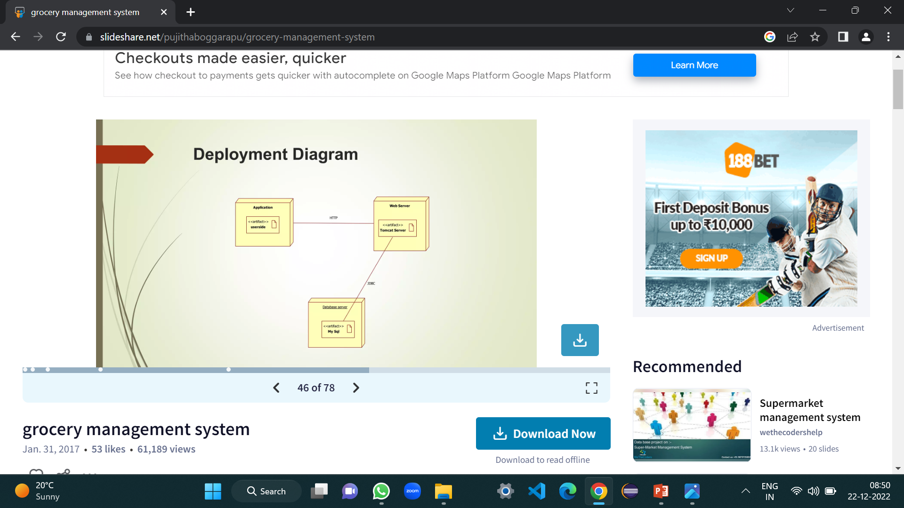
Deployment Diagram

Slide 51
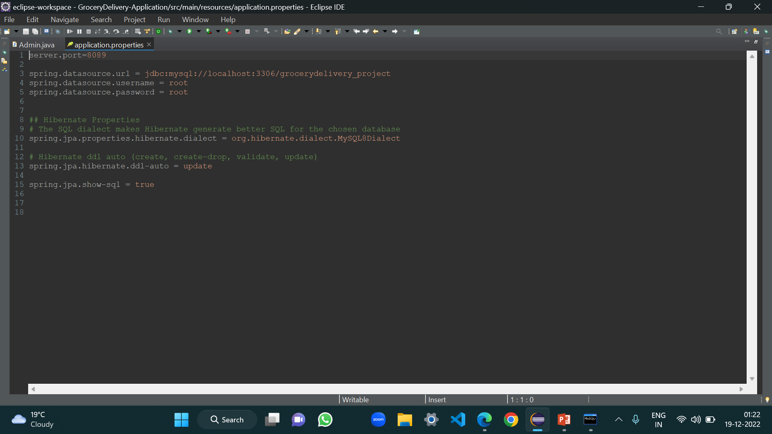
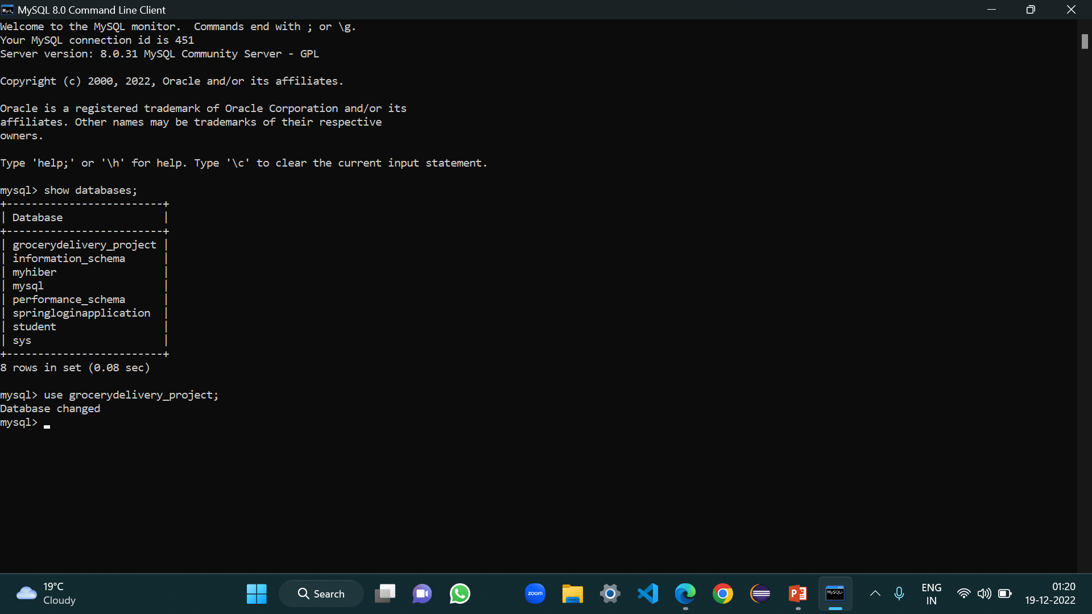
“ Project Database “

Slide 52
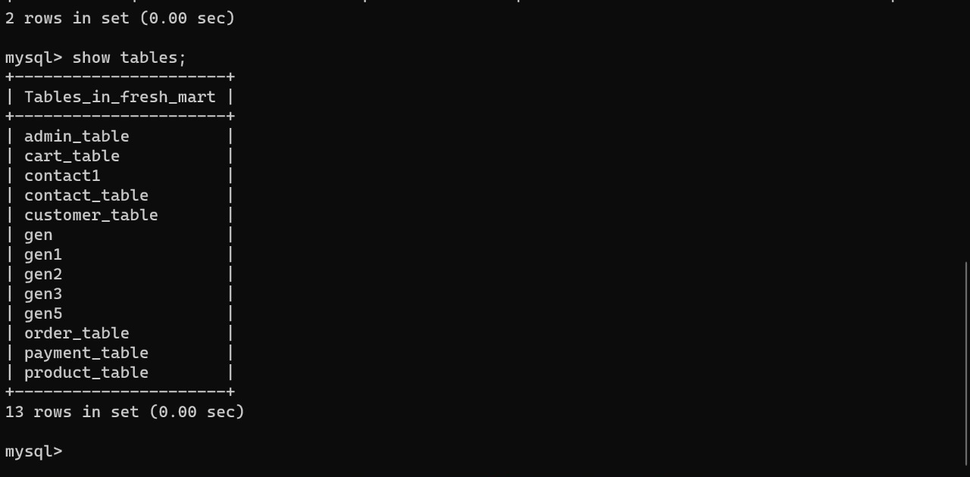
“ Tables ”

Slide 53
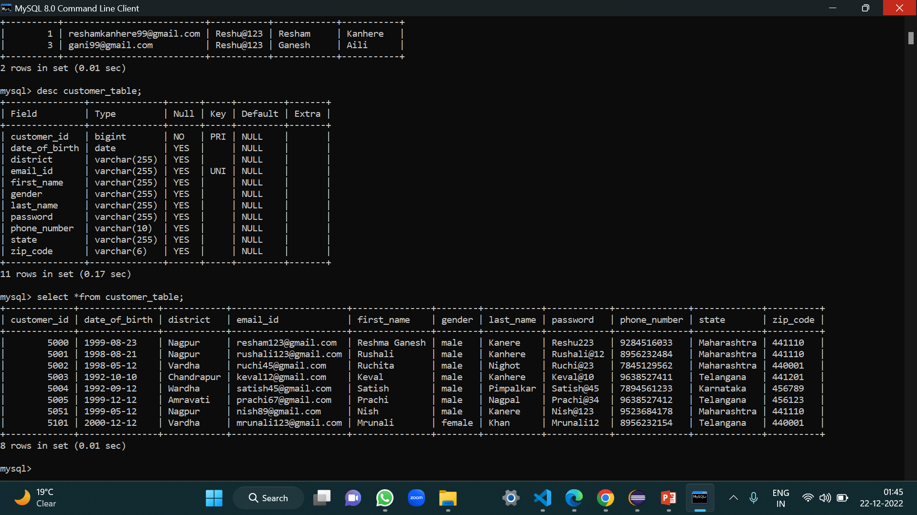
“ Customer Table “

Slide 54
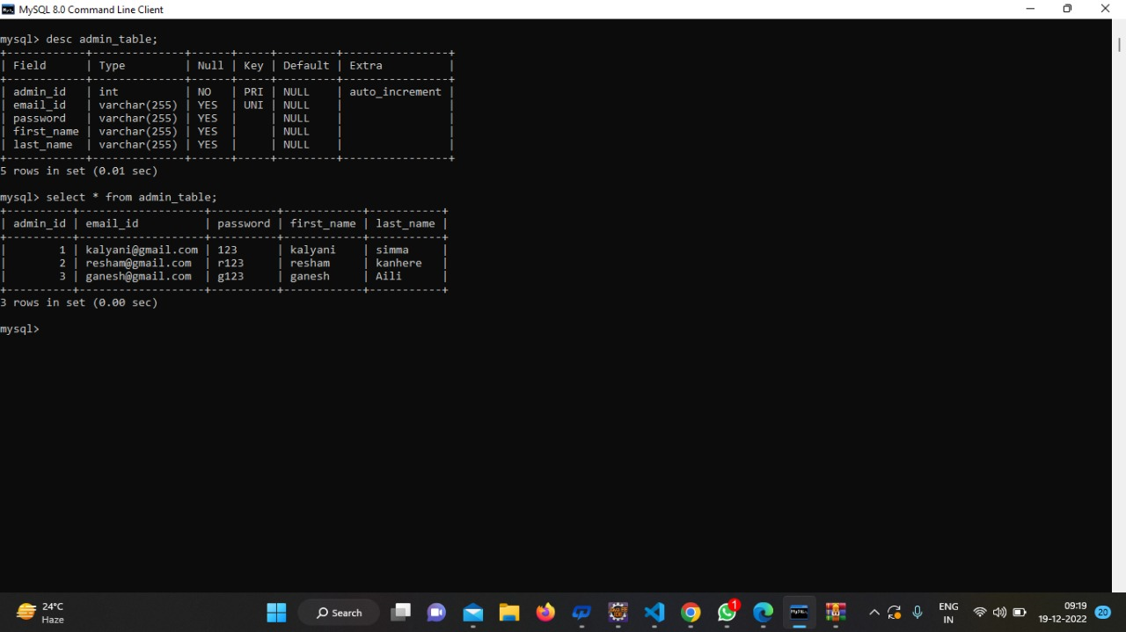
“ Admin Table “

Slide 55
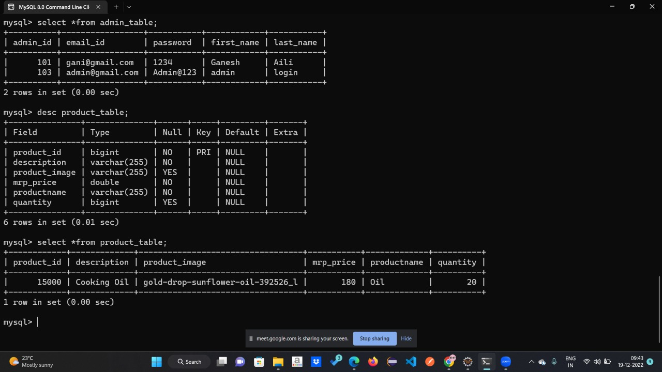
“ Product Table “

Slide 56
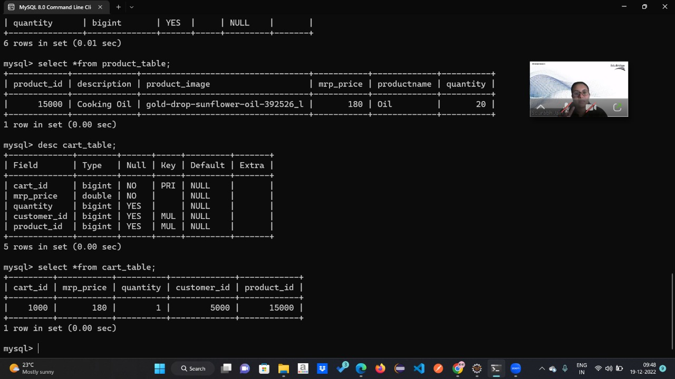
“ Cart Table “

Slide 57
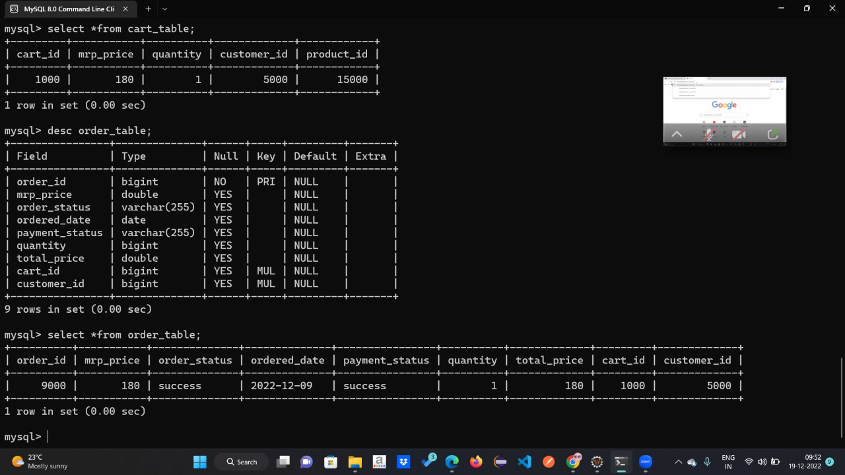
“ Order Table “

Slide 58
“ Payment Table “

Slide 59

“ Postman “
POSTMAN is an API platform for building and using APIs. Postman simplifies each step of the API lifecycle and streamlines collaboration so you can create better APIs—faster.
API repository
Easily store, catalog, and collaborate around all your API artifacts on one central platform. Postman can store and manage API specifications, documentation, workflow recipes, test cases and results, metrics, and everything else related to APIs.
Tools
The Postman platform includes a comprehensive set of tools that help accelerate the API lifecycle—from design, testing, documentation, and mocking to the sharing and discoverability of your APIs.

Slide 60
Governance
Postman’s full-lifecycle approach to governance lets adopters shift left their development practices, resulting in better-quality APIs, and fostering collaboration between developer teams and API design teams.
Workspaces
Postman workspaces help you organize your API work and collaborate across your organization or across the world. There are four different kinds of Postman workspaces for your different needs: personal, team, partner, and public workspaces.
Integrations
Postman integrates with the most important tools in your software development pipeline to enable API-first practices. The Postman platform is also extensible through the Postman API and through open source technologies.

Slide 61
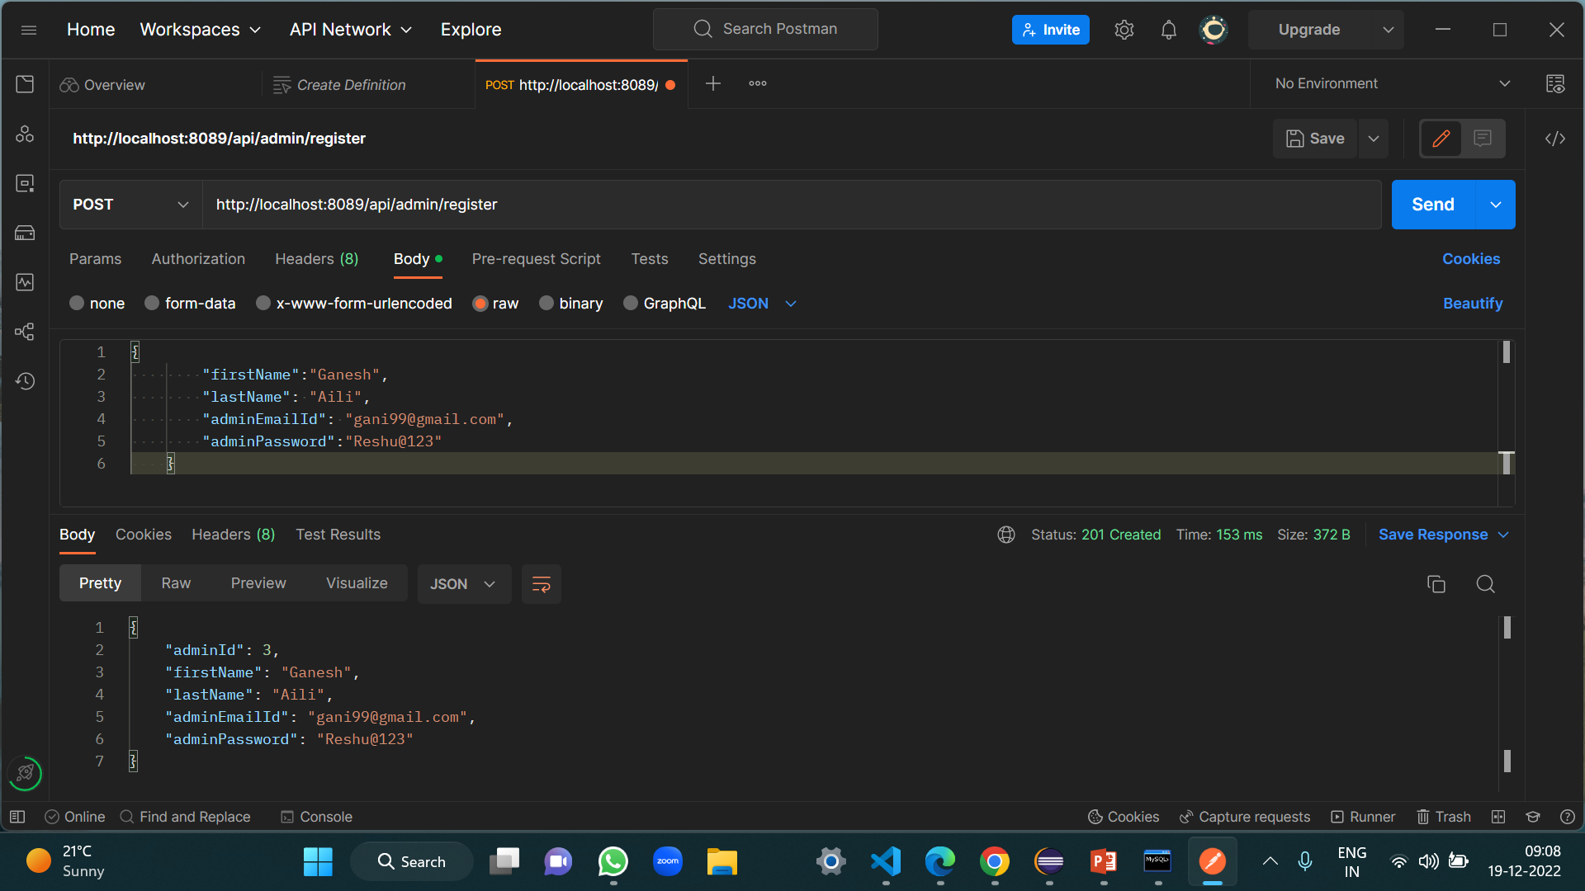
“ Insert Admin Data Using Postman
http://localhost:8089/api/admin/register ”

Slide 62

“ Retrieve Customer’s Data Using Postman Get Method
http://localhost:8089/api/customers ”

Slide 63

“ Insert Customer Data Using Postman Post Method
http://localhost:8089/api/customer/register “

Slide 64

“Update Customer’s Data Using Postman Put Method
http://localhost:8089/api/customer/{id} “

Slide 65

“ Delete Customer’s Data Using Postman Delete Method
http://localhost:8089/api/customer/{id} “

Slide 66

“ Advantages ”
Clients can order whenever they want to order.
Makes the ordering process easier.
Customer’s satisfaction.
The convenience of mobile ordering.
No more waiting in long queues to place an order.
Fresh and healthy.

Slide 67



“ Conclusion ”
Finally, in the FRESH-MART , we have a system where users order the item according to the wish given by the filters he/she chooses and specify the no, of it and makes the payment.
He/she gets the order as staff picks out the items from the racks and give to the user.
Admin assigns the staff to the racks.
In the analyzes, the profit and gain and booking for the customers.

Slide 68




“ Thank You.. ”
“ Visit Again..”

